Slide 1
Finding Internal Forces via Equilibrium Analysis
Dr. Jacob Moore
Associate Professor of Engineering
Penn State Mont Alto

Slide 2
Internal Forces
Internal forces are forces that exist within a body that must exist balance out the external forces on the body.
a
a
a
a

Slide 3
Finding the Internal Forces via Equilibrium Analysis
The most straightforward approach to finding the internal forces and the internal moments at a particular point is to perform an equilibrium analysis of half of the body, cutting the body in two at the point of interest.
The steps of the process are as follows:
Start by finding all the necessary external forces on the original body.
Next, draw a free body diagram of one half of the body, drawing in an unknown normal force, shearing force(s), bending moment(s), and torsional moments.
Write up the equilibrium equations for the half of the body.
Solve the equilibrium equations for the unknowns

Slide 4
Step 1: Finding External Forces
Before you can find the internal forces in a body, you need to know the external forces acting on a body.
In a 2D problem, you will have two unknown internal forces and an unknown internal moment when you cut the body in two.
In a 3D problem, you will have three unknown internal forces and three unknown internal moments when you cut the body in two.
In either case, the number of new unknowns will be exactly the number of equilibrium equations you will have available.
The one shortcut we have is that we only really need to know the external forces we have on the one half of the body we plan to work with.
Finding the external forces is just a traditional statics problem (equilibrium analysis of a rigid body).

Slide 5
Step 2: Splitting the Body and Drawing a Free Body Diagram
46.7 N
46.7 N
After finding all the external forces, the next step in the process is to imagine cutting the body at the point of interest and drawing a free body diagram of one half of the body.
Either side will work, choose the option that is going to be easiest for you.
Draw in an unknown normal force, an unknown shear force and an unknown bending moment at the cross section.
40º
40º
a
a
60 N
46.7 N
46.7 N
N
M_{r}
40º
40º
V
a
a
V
a
a
M_{r}
60 N
N

Slide 6
Step 2: Splitting the Body and Drawing a Free Body Diagram
In a 3D system we will do the same thing, except there will be an unknown normal force and two unknown shear forces at the cut, and there will be two unknown bending moments and an unknown torsional moment at the cut.
V₁
M₁
V₂
T
M₂
N

Slide 7
Step 3 and 4: Equilibrium Analysis
If the whole body is in equilibrium, then each section of the body is in equilibrium.
Once you set up your free body diagram with the unknown internal forces and moments, simply write out the equilibrium equations for that half of the body.
You should always have exactly as many equations as unknown internal forces.
Finally, solve the equilibrium problems for the unknown internal forces.

Slide 8
Newton’s Third Law and Internal Forces
46.7 N
46.7 N
When solving for these forces, it’s important to realize that the forces on one half will be equal and opposite to the forces on the other half.
Which side you choose determines the direction of these forces.
For this reason, it’s important to show the final forces on a diagram, rather than just providing numbers and a direction.
40º
40º
V
a
a
M_{r}
N
N
M_{r}
V
a
a
60 N
8

Slide 9
Solving an Internal Force Problem (The Process)
The process used in solve for internal forces (using equilibrium analysis is as follows:
Solve for all the external forces and moments
At least all the external forces and moments acting on the side of the body you intend to work with.
Draw a free body diagram of half of the body, making the cut at the point of interest.
Include the external forces and moments acting on that half of the body.
Include the unknown internal forces and include the unknown internal moments.
Write out all the equilibrium equations based on the free body diagrams.
Solve the equilibrium equations for the unknown values.

Slide 10
Thanks for Watching
See other engineering mechanics videos and access the full tool at…

Slide 11
Internal Forces Worked Example
A mounting bracket with the dimensions shown below is subjected to a 200 lb force. Determine all internal forces and moments at cross section a-a.
4 in
35º
3 in
200 lbs
a
a

Slide 12
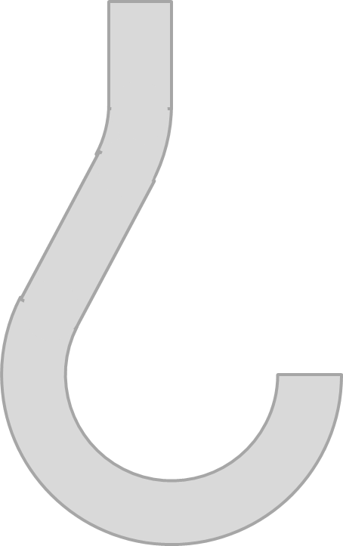
Internal Forces Worked Example
A hook with a 12 mm curve at the bottom is subjected to a 60N force as shown. Determine all internal forces and moments at cross section a-a.
r = 12mm
a
a
60 N

Slide 13
Internal Forces Worked Example
A mounting bracket with the dimensions shown below is subjected to a 700 N load and two 350 N reaction forces. Determine all internal forces and moments at points B and C.
350 N
E
30 cm
30 cm
25 cm
C
B
D
350 N
25 cm
A
700 N

